Slide 1
Where do my fingers go?

Slide 2
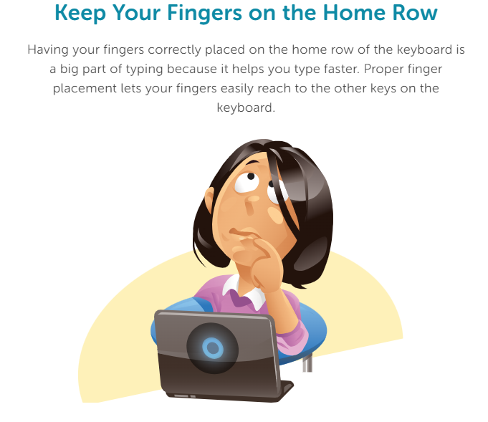

Slide 3
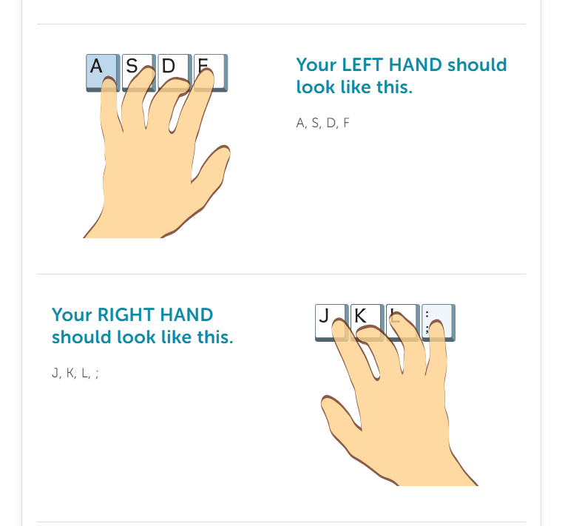

Slide 4
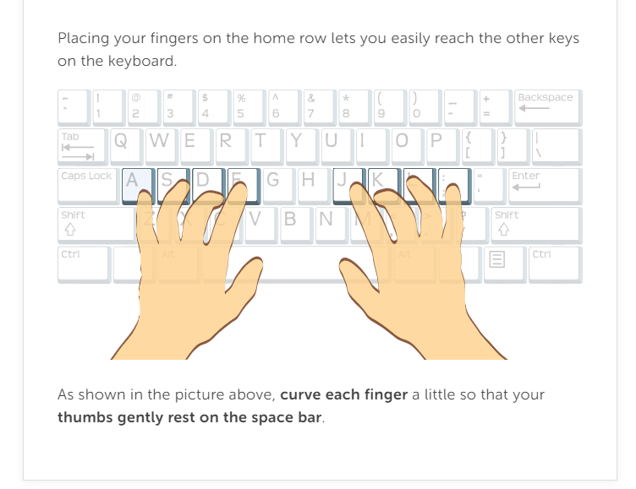

Slide 5
Complete Where Do My Fingers Go Review Packet

